Slide 1
Chapter 2
Scanning
Finite Automata
Lijie Li
College of Computer Science & Technology
Harbin Engineering University
compiler
1

Slide 2
线上签到
请大家在智慧树见面课中签到
compiler

Slide 3
课前测验
“由小写字母组成的、以a开头并且以a结尾的字符串”的正则表达式是（ ）
A. a[a-z]*a
B. (a[a-z]*a)|a
C. a[a-z]⁺a
D. 以上都错
compiler

Slide 4
课前测验
（ ）这样一些语言，它们能用正则表达式表示，但不能被确定的有穷自动机识别。
A. 存在
B. 不存在
C. 无法判定是否存在
D. 满足某种条件下存在
compiler
Samuel2005@126.com

Slide 5
Finite automata
Definition of Deterministic Finite Automaton
Uniting DFAs
compiler

Slide 6
Finite Automata
Finite automata, or finite-state machines, are a mathematical way of describing particular kinds of algorithms.
Finite automata can be used to recognize patterns.
There is a strong relationship between finite automata and regular expressions.
compiler

Slide 7
Example
identifier = letter(letter|digit)*
Circles represent states.
The arrowed lines represent transitions upon a match of the labeled characters.
Start state is indicated by unlabeled arrow
Accepting states are indicated by double-line border.
letter
letter
1
2
digit
compiler

Slide 8



Deterministic Finite Automaton
Deterministic Finite Automaton
A DFA M consists of
  An alphabet Σ
  A set of states S
  A transition function T: (S × Σ) → S
  A start state s₀ S
  A set of accepting states A S
The language accepted by M, written L(M), is the set of strings of characters c₁c₂…c_{n} with each c_{i} Σ such that there exist states s₁=T(s₀,c₁), s₂=T(s₁,c₂), …. s_{n}=T(s_{n-1},c_{n}) with s_{n} an element of A.
compiler

Slide 9
Error Transitions
letter
letter
1
2
digit
other
other
Error
other = ~letter
other = ~(letter|digit)
By convention, the error transitions are not drawn in the diagram, but assumed to always exist.
compiler

Slide 10
Example 2.6
The set of strings that contain exactly one b is accepted by the following DFA:
notb=~b
We will omit labels when it is not necessary to refer to the states by name.
notb
notb
b
compiler

Slide 11
Example 2.7
The set of strings that contain at most one b is accepted by the following DFA:
抢答！！
We will omit labels when it is not necessary to refer to the states by name.
notb
notb
b
compiler

Slide 12
Example 2.8
digit
digit = [0-9]
nat = digit+
signedNat = (+|-)? nat
digit
digit
+
digit
digit
-
digit
compiler

Slide 13
Example 2.8 (cont)
number = signedNat(“.” nat)?(E signedNat)?
digit
digit
digit
+
+
digit
.
digit
digit
E
-
-
digit
E
digit
compiler

Slide 14
Example 2.9
{Pascal Comments}
/* C Comments */
other
{
}
other
*
/
*
*
/
other
compiler

Slide 15
Actions
When a transitions is made, the character from the input string is moved to a string that accumulates the characters belonging to a single token (lexeme of the token).
When an accepting state is reached, the recognized token is returned.
When an error state is reached, an error token is generated or backtracking is done.
compiler

Slide 16
Example
letter
letter
1
2
digit
letter
letter
[other]
start
in_id
finish
return ID
digit
[ ] indicate that the delimiting character should be returned to the input string and not consumed.
compiler

Slide 17
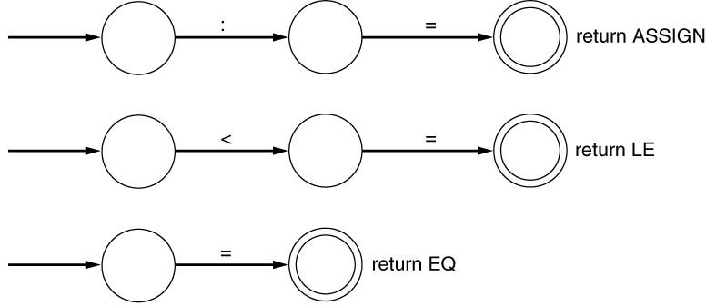
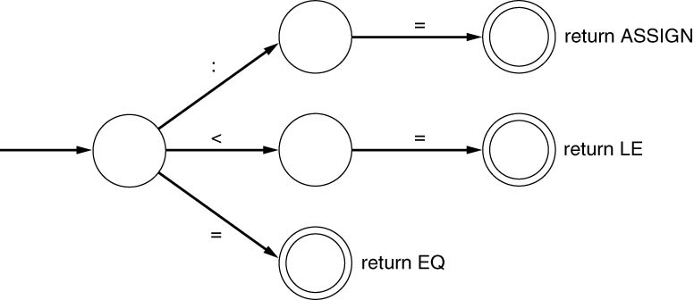
Uniting DFA’s
In a typical programming language there are many tokens, and each token is recognized by its own DFA.
If each token begins with a different character, then it is easy to unite their start states into one start state.
  Example: :=, <=, =
compiler

Slide 18
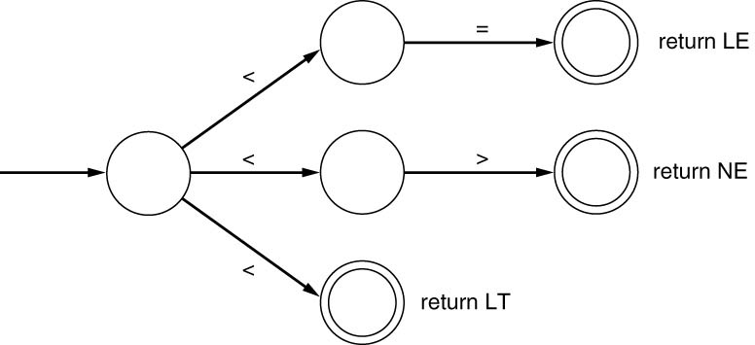
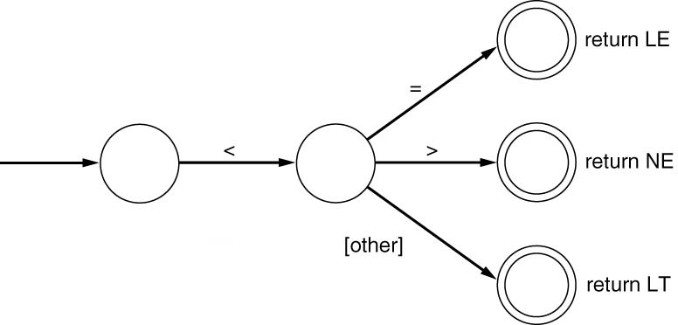
Uniting DFA’s (cont)
If several tokens begin with the same character, such as <, <=, and < >, we must arrange the diagram so that there is a unique transition to be made to each state.
  The complexity of such task becomes enormous, especially if it is done in an unsystematic way.
compiler

Slide 19
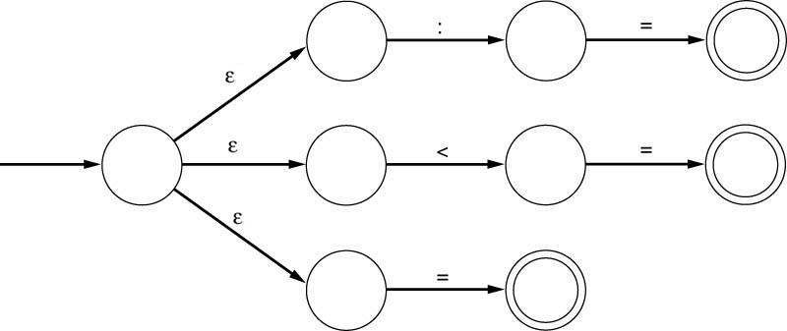
ε - transition
An ε-transition is a transition that may occur without consulting the input string (and without consuming any character).
ε-transitions are counterintuitive, they may occur “spontaneously”.
They can express the choice of alternatives and allow to combine DFA’s.
ε
compiler

Slide 20
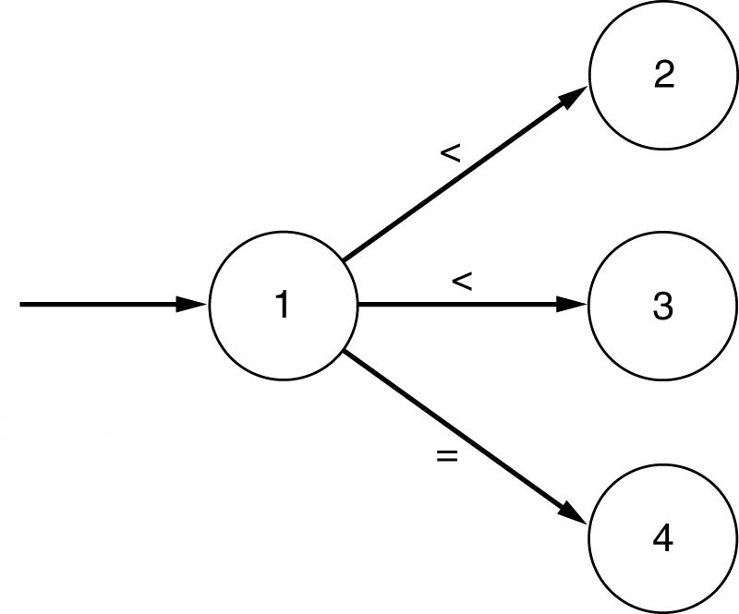
Expanding DFA
Need to include ε in the alphabet: Σ ∪ {ε}
The value of transition function T is a set of states rather than a single state.
  T allows each character lead to more than one state.
The range of T is the power set of the set of states S (the set of all subsets of S).
We denote the power set by P (S)
T( 1, < ) = { 2, 3 }
compiler

Slide 21
Nondeterministic Finite Automaton
Nondeterministic Finite Automaton
An NFA M consist of
  An alphabet Σ
  A set of states S
  A transition function T: S × (Σ ∪ {ε}) → P (S)
  A start state s₀ from S
  The set of accepting states A from S
The language accepted by M, written L(M), is the set of strings of characters c₁c₂…c_{n} with c_{i} from (Σ ∪ {ε}) such that there exist states s₁ in T(s₀,c₁), s₂ in T(s₁,c₂),…, s_{n} in T(s_{n-1},c_{n}) with s_{n} an element of A.
compiler

Slide 22
Some Notes
Any of c_{i} in c₁c₂…c_{n} may be ε. The string that is actually accepted is the string with the ε’s removed.
  The accepted string may actually have fewer than n characters.
The sequence of states s₁s₂…s_{n} will not be always uniquely defined.
NFA does not represent an algorithm. It can be simulated by an algorithm that backtracks through every nondeterministic choice.
compiler

Slide 23
Example 2.10
2
ε
a
b
a
ε
1
3
4
ε
The string abb can be accepted by either of the following sequences of transitions
This NFA accepts the language of the regular expression or
1 → 2 → 4 → 2 → 4
1 → 3 → 4 → 2 → 4 → 2 → 4
ab+
|ab*
|b*
(a | ε) b*
compiler

Slide 24
Example 2.10 (cont)
The language generated by (a | ε)b* is accepted by the following DFA:
a
b
b
b
compiler

Slide 25
Implementation of DFA
letter
1
letter
2
[other]
return ID
3
digit
{starting in state 1}
if the next character is a letter then
advance the input; {now in state 2}
while the next character is a letter or a digit do
advance the input; {stay in state 2}
end while;
{go to state 3 without advancing the input}
accept;
else
{error or other cases}
endif
compiler

Slide 26
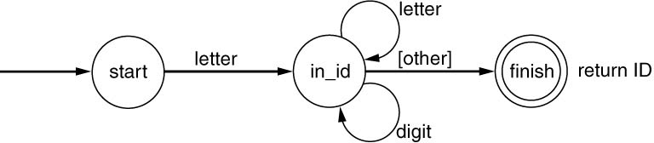
Another Implementation
state:=1; {start}
while state =1 or 2 do
case state of
1: case input character of
letter: advance the input;
state:=2;
else state:=…{error or other};
end case;
2: case input character of
letter, digit: advance the input;
state:=2; {acturally unnecessary}
else state:=3;
end case;
end case;
end while;
if state=3 then accept else error;
This is a better implementation method.
It uses a variable to maintain the current state.
The transitions are implemented using a doubly nested switch statements inside a loop.
compiler

Slide 27
Transition Table
letter
letter
[other]
1
2
3
digit
input char state | letter | digit | other | Accepting
1 | 2 |  |  | no
2 | 2 | 2 | [3] | no
3 |  |  |  | yes
compiler

Slide 28
Transition Table Implementation
state:=1;
ch:=next input character;
while not Accept[state] and not error(state) do
newstate:= T[state][ch];
if Advance[state][ch] then ch:=next input char;
state:=newstate;
end while;
if Accept[state] then accept;
Boolean array Advance, indexed by states and characters, indicates the transitions that advance the input.
Boolean array Accept, indexed by states, indicates accepting states.
The same code will work for many different problems.
Transition tables may require a lot of space.
compiler

Slide 29
From Regular Expression to DFA
Regular expression
NFA
DFA
Program
compiler

Slide 30
课前测验
（ ）这样一些语言，它们能用正则表达式表示，但不能被确定的有穷自动机识别。
A. 存在
B. 不存在
C. 无法判定是否存在
D. 满足某种条件下存在
compiler

Slide 31
课后测验
（ ）不是NFA的成分。
A. 字母表
B. 初始状态集合
C. 终结状态集合
D. 有限状态集合
compiler

Slide 32
Homework
2.8 Draw a DFA for each of the sets of characters of (a)-(d) in Exercise 2.1, or state why no DFA exists.
compiler

